Slide 1
Lecture
Binary and Hexadecimal Numbers

Slide 2
How Machines Think
Computers handle two types of information:
  Instructions
  Data
The "words" of a machine language are called instructions; each of these gives a command to the CPU
A computer program (software) is a list of instructions that are executed by the CPU

Slide 3
Off and On
Computers only recognize off and on, like a light switch
These switches are represented as binary digits or… bits
Instructions and data are composed only of a series of bits

Slide 4
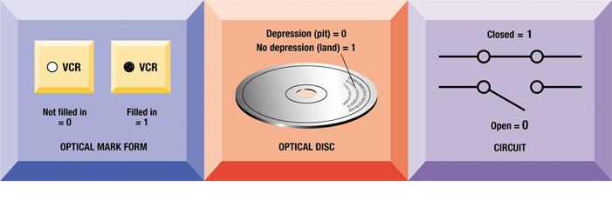
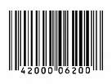
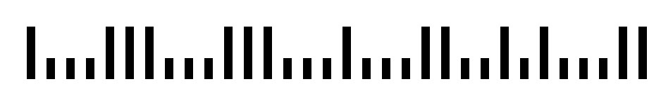
Binary Numbers (Bits)
Bits can be represented as:
  1 or 0
  On or Off
  Up or Down
  Open or Closed
  Yes or No
  Black or White
  Thick or Thin
  Long or Short

Slide 5
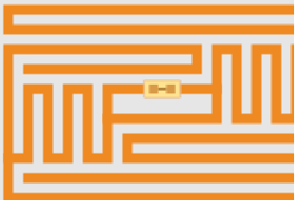
Bar Codes vs. RFID
RFID (discuss in Lab 1) Radio Frequency Identification.
  Used by Walmart or other retailers to track goods
  Has a circuit that can be transmitted to nearby radio device
Bar codes cost .005 cents per code
RFID devices cost 7¢ to 30 ¢
per iterm

Slide 6
We count in Base 10 (Decimal)
15
16
17
18
19
0
1
2
3
4
5
6
7
8
9
10
11
12
13
14
95
96
97
98
99
100
101
20
21
22
23
24
Ran out of symbols (0-9), so increment the digit on the left by one unit.

Slide 7
Computers count in Base 2 (Binary)
Counting in Binary is the same, but with only two symbols
  On (1)
  Off (0)
1000
1001
1010
1011
1100
1101
1110
1111
10000
0
1
10
11
100
101
111
110

Slide 8
Converting Binary to Decimal
1 0 1 0 1 1 0 0
128
64
32
16
8
4
2
1
128
+
0
+
32
+
0
+
8
+
4
+
0
+
0
128 + 32 + 8 + 4 = 172

Slide 9
Converting Binary to Decimal
0 1 0 1 0 0 0 1
128
64
32
16
8
4
2
1
0
+
64
+
0
+
16
+
0
+
0
+
0
+
1
64 + 16 + 1 = 81

Slide 10
Converting Binary to Decimal
- - - ✓ - ✓ ✓ ✓
128
64
32
16
8
4
2
1
0
+
0
+
0
+
16
+
0
+
4
+
2
+
1
16 + 4 + 2 + 1 = 23

Slide 11
Converting Binary to Decimal
☺ ☹ ☺ ☺ ☹ ☺ ☺ ☺
128
64
32
16
8
4
2
1
128
+
0
+
32
+
16
+
0
+
4
+
2
+
1
128 + 32 + 16 + 4 + 2 + 1 = 183

Slide 12
Bytes
Eight bits form a single byte
  “00110011” is One Byte of Information
Byte Values:
  00000000 = 0
  11111111 = 255
As a result, binary numbers almost always written as a full byte (00000001).

Slide 13
Size Matters
Computer memory and storage capacities are represented by their size (megs, gigs, etc)
  1 , 0 = 1 bit
  4 bits = 1 hex character (nibble)
  8 bits = 1 byte
  2^10 = 1,024 bytes or 1 Kilobyte (thousand)
  2^20 = 1,048,576 bytes or 1 Megabyte (million)
  2^30 = 1,073,741,824 or 1 Gigabyte (billion)
  2^40 = 1,099,511,627,776 bytes or
  1 Terabyte (trillion)

Slide 14
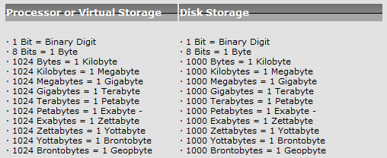
Future Size Considerations
Thousand, Million, Billion, Trillion, Quadrillion, Quintillian, Hexillion, Heptillion

Slide 15
Binary Influence
Nintendo 64
  64 = 01000000
Color Combinations
  256 Colors
Storage
  1024 MB of RAM (1024 is 256 x 4)
IP addresses: 255.255.255.255
  IP address are comprised of 4 eight-bit numbers
  111111111.11111111.11111111.11111111

Slide 16
Binary to Hexadecimal
Base 16 instead of Base 2
16 characters are used instead of 2
Every Hex character represents 4 bits
4 bits = 1 nibble (or hex character)
2 nibbles (2 hex characters) = 1 byte
Easier to get to larger numbers faster

Slide 17
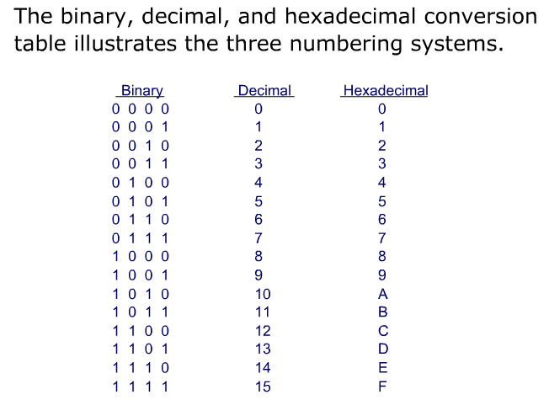
Binary to Hexadecimal

Slide 18
Computers recognize Base 16 (hex)
Counting in Hex is the same as counting in Bin, but with sixteen symbols
Still translates to binary
0 1 2 3 4 5 6 7 8 9 A B C D E F
0 = 0000 1 = 0001 2 = 0010 3 = 0011
4 = 0100 5 = 0101 6 = 0110 7 = 0111
8 = 1000 9 = 1001 A =1010 B = 1011
C = 1100 D=1101 E= 1110 F = 1111

Slide 19
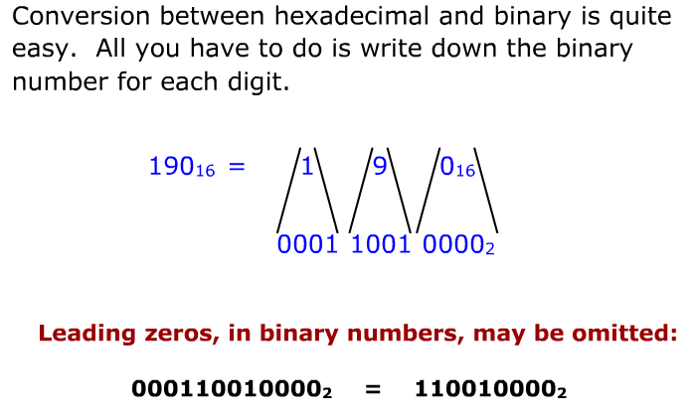
Converting Hex to Bin

Slide 20
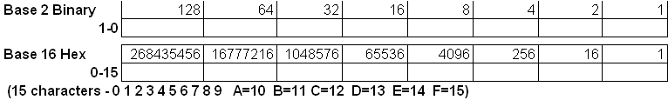
Base 16 Hex multiplies by 16 instead of 2 or 10
The hexadecimal system is useful because it can represent every byte (8 bits) as two consecutive hexadecimal digits. It is easier for humans to read hexadecimal numbers than binary numbers.

Slide 21
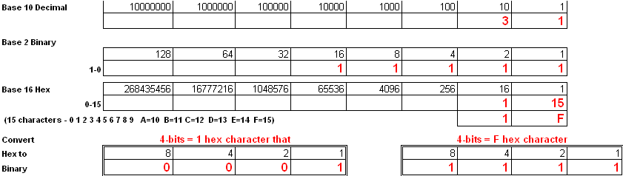
Let’s Practice Hex! 31
Base 10 = 30 + 1 or 31
Base 2 = 16 + 8 + 4 + 2 + 1 or 1 1 1 1 1
Base 16 = 16 + 15 or 1F (remember only 1 character in hex --- hence we use the letter F to represent the number 15

Slide 22
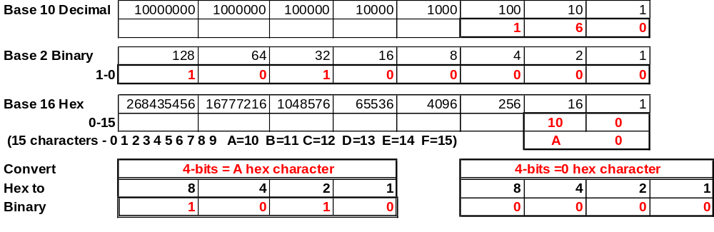
Let’s Practice Hex! 160
Base 10 = 100+60+0 or 160
Base 2 = 128+0+32+0+0+0+0+0 0r 10100000
Base 16 = 16 x 10 (160) + 0 or A 0 (remember only 1 character in hex --- hence we use the letter A to represent the number 10

Slide 23
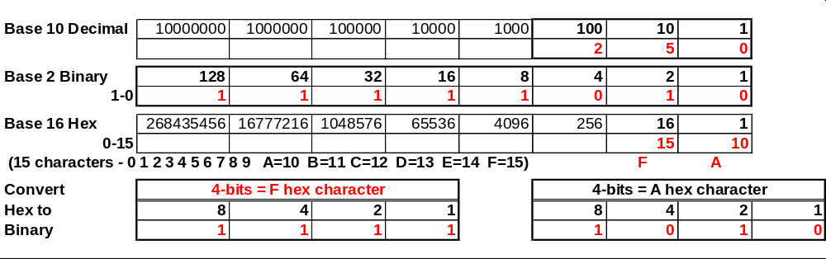
Let’s Practice Hex! 250
Base 10 = 200+50+0 or 250
Base 2 = 128+64+32+16+8+0+2+0 or 11111010
Base 16 = 16 x 15 = 240 + 1 x 10 = 10 or F A (remember only 1 character in hex --- hence we use the letter F to represent the number 15

Slide 24
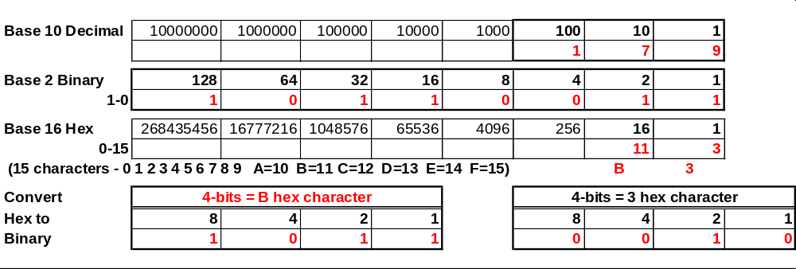
Let’s Practice Hex! 179
Base 10 = 100 + 70 + 9 or 179
Base 2 = 128 + 0 + 32 + 16 + 0 + 0 + 2 + 1 or 10110011
Base 16 = 16 x 11 = 176 + 1 x 3 or B 3 (remember only 1 character in hex --- hence we use the letter B to represent the number 11

Slide 25
ASCII (Character Set)
American Standard Code for Information Interchange
Provides a means for a byte to represent a number
  0100 0001 (41 Hex) (65 Dec) = A
  0100 0010 (42 Hex) (66 Dec) = B
Upper-case and lower-case have separate values.
Numbers and symbols are there too.
Boolean Algebra

Slide 26
ASCII Table
1-31 Control Codes
32-64 Symbols
65-90 Uppercase
91-96 More Symbols
97-122 Lowercase
123-126 More Symbols
127 Delete
128-255 International Symbols

Slide 27
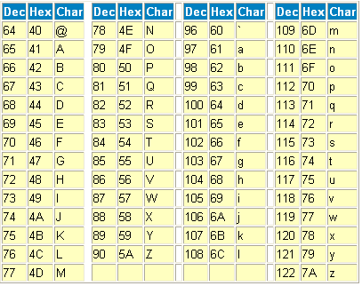
ASCII Table
Link to complete ASCII Chart

Slide 28
Alpha to Hex to Binary nibbles
Alpha
Hex
8 4 2 1
8 4 2 1
C (43)
O (4F)
M (4D)
P (50)
2 (32)
5 (35)
0100 0011
0100 1111
0100 1101
0101 0000
0011 0010
0011 0101
Hex gets there “FASTER” than Binary only for programming code

Slide 29
ASCII Symbols and Characters
Symbols and characters:
  !
  @
  (space)
  "
33 or #21 or 0010 0001
64 or #40 or 0100 0000
32 or #20 or 0010 0000
34 or #22 or 0010 0010
Hex Characters convert to binary so each symbol has a binary representation

Slide 30
Other Character Sets
UTF – Unicode Transformation Formats
UTF-8; dominant – uses 1-4 bytes to represent characters
UTF-16
UTF-32

Slide 31
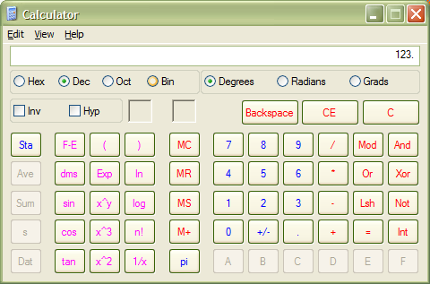
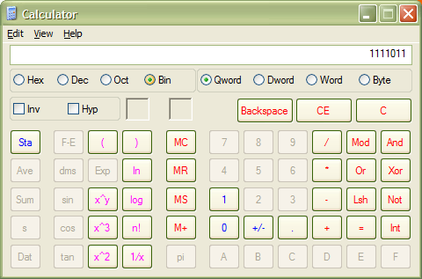
Windows Calculator for Binary
1. Type your number.
3. See new value.
2. Choose notation.

Slide 32
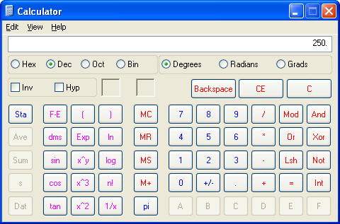
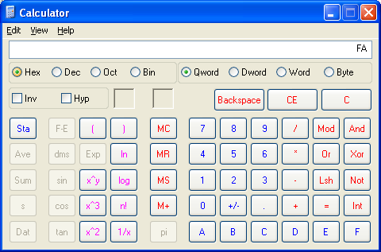
Windows Calculator for Hex
1. Type your number.
3. See new value.
2. Choose notation.

Slide 33
Binary Addition – Rules!
Remember elementary school
  Carry
  Double Digits
New Rules
  0 0 1 1
  0 1 0 1
  0 1 1 10

Slide 34
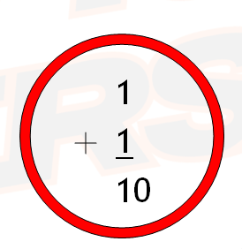
Why?

Slide 35
There are 10 types of people in the world... Those who understand binary, and those who don’t.

